Slide 1
MatCalc approach for the modelling of the vacancy concentration evolution
(MatCalc 5.60.0005)
P. Warczok

Slide 2
Outline
Vacancy concentration
  What is it all about?
  Why do we care about?
  How does it evolve?
  Why does it (sometimes) take so long to evolve?

Slide 3
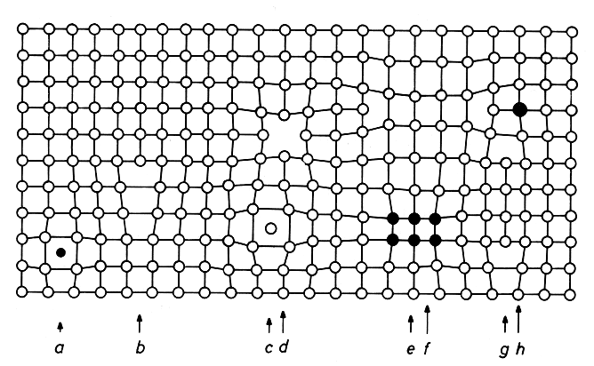
What is it all about?
Real materials are not perfect crystals...
http://www.tf.uni-kiel.de/matwis/amat/def_en/overview_main.html

Slide 4
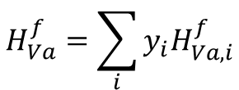
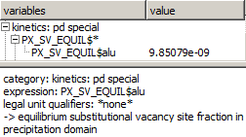
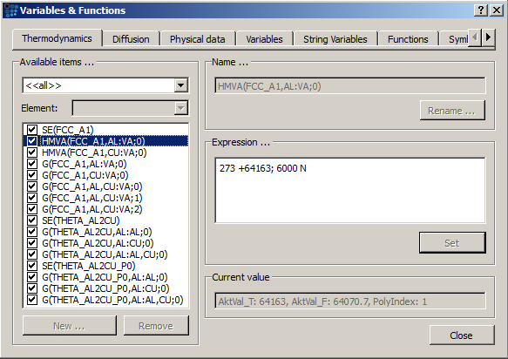
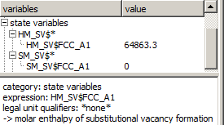

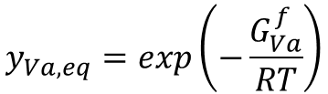
What is it all about?
Equilibrium vacancy concentration → thermodynamics make them appear
$$y_{Va,eq}=exp\left(−\frac{G_{Va}^{f}}{RT}\right)$$
$$G_{Va}^{f}=H_{Va}^{f}−TS_{Va}^{f}$$

Slide 5
What is it all about?
Equilibrium vacancy concentration → thermodynamics make them appear
$$y_{Va,eq}=exp\left(−\frac{G_{Va}^{f}}{RT}\right)$$
Vacancy formation entropies are currently not used in MatCalc
Vacancy formation enthalpies come from thermodynamic database. Feel free to change it, if you need it (Variables& function)
$$G_{Va}^{f}=H_{Va}^{f}−TS_{Va}^{f}$$

Slide 6
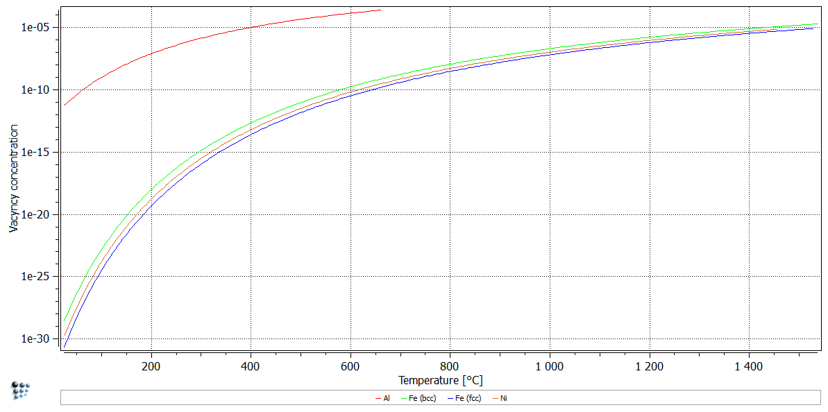
What is it all about?
Equilibrium vacancy concentration → thermodynamics make them appear

Slide 7
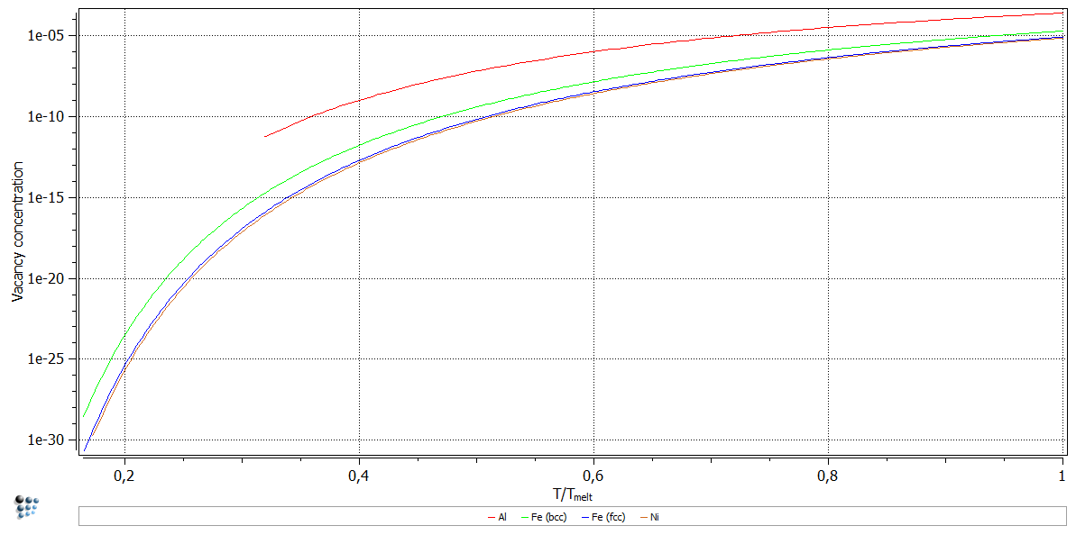
What is it all about?
Equilibrium vacancy concentration → thermodynamics make them appear

Slide 8
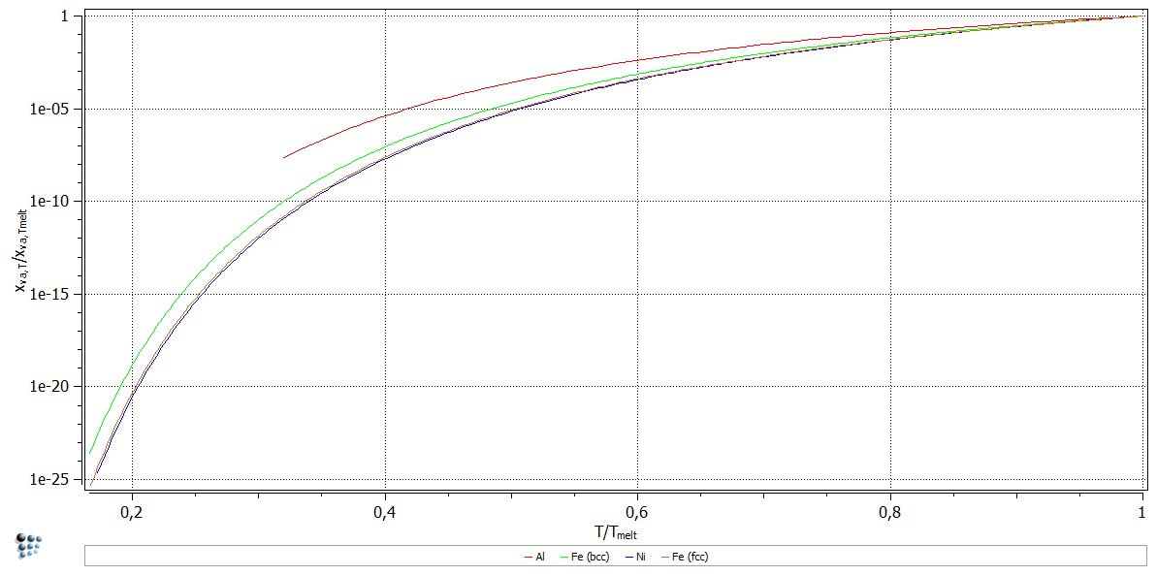
What is it all about?
Equilibrium vacancy concentration → thermodynamics make them appear

Slide 9
What is it all about?
How to change the vacancy concentration?
  New equilibrium
    Change temperature
    Transform to a new phase
  Out of equilibrium
    Deform material
    Irradiate material

Slide 10
Why do we care?
Nucleation
Precipitation kinetics
Vacancies
Diffusion

Slide 11
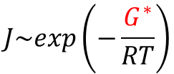
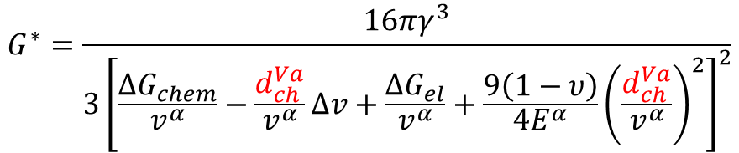
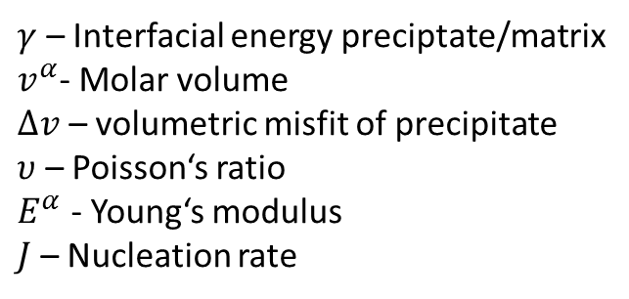
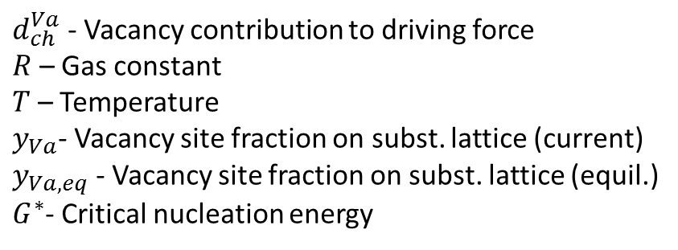
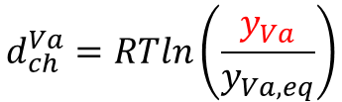
Why do we care?
Precipitation kinetics
Vacancies
Nucleation
$$G^{∗}=\frac{16πγ^{3}}{3{\left[\frac{{ΔG}_{chem}}{v^{α}}−\frac{d_{ch}^{Va}}{v^{α}}Δv+\frac{{ΔG}_{el}}{v^{α}}+\frac{9\left(1−υ\right)}{{4E}^{α}}{\left(\frac{d_{ch}^{Va}}{v^{α}}\right)}^{2}\right]}^{2}}$$
$$d_{ch}^{Va}=RTln\left(\frac{y_{Va}}{y_{Va,eq}}\right)$$
$$J\sim exp\left(−\frac{G^{∗}}{RT}\right)$$
Chemical part
Elastic part
$d_{ch}^{Va}$ - Vacancy contribution to driving force
$R$ – Gas constant
$T$ – Temperature
$y_{Va}$- Vacancy site fraction on subst. lattice (current)
$y_{Va,eq}$ - Vacancy site fraction on subst. lattice (equil.)
$G^{∗}$- Critical nucleation energy
$γ$ – Interfacial energy preciptate/matrix
$v^{α}$- Molar volume
$Δv$ – volumetric misfit of precipitate
$υ$ – Poisson‘s ratio
$E^{α}$ - Young‘s modulus
$J$ – Nucleation rate

Slide 12

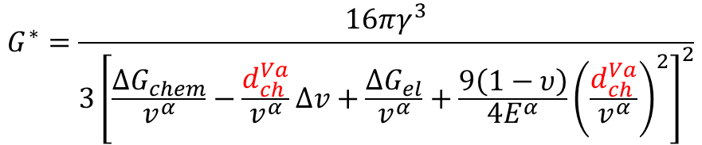
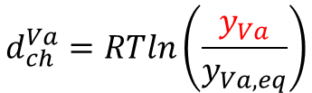
Why do we care?
Precipitation kinetics
Vacancies
Nucleation
$$G^{∗}=\frac{16πγ^{3}}{3{\left[\frac{{ΔG}_{chem}}{v^{α}}−\frac{d_{ch}^{Va}}{v^{α}}Δv+\frac{{ΔG}_{el}}{v^{α}}+\frac{9\left(1−υ\right)}{{4E}^{α}}{\left(\frac{d_{ch}^{Va}}{v^{α}}\right)}^{2}\right]}^{2}}$$
$$d_{ch}^{Va}=RTln\left(\frac{y_{Va}}{y_{Va,eq}}\right)$$
$$J\sim exp\left(−\frac{G^{∗}}{RT}\right)$$
Chemical part
Elastic part
Generation/anihilation of the excess vacancies results in a strain of the matrix (last term)
Volumetric misfit of the precipitate may augment/decay the previous effect (second term)

Slide 13
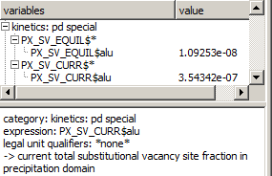
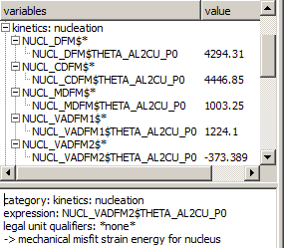
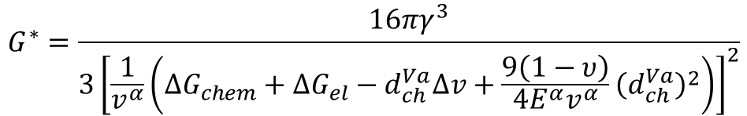
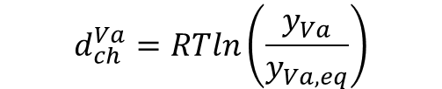
Why do we care?
$$d_{ch}^{Va}=RTln\left(\frac{y_{Va}}{y_{Va,eq}}\right)$$
$$G^{∗}=\frac{16πγ^{3}}{3{\left[\frac{1}{v^{α}}\left({ΔG}_{chem}+{ΔG}_{el}−d_{ch}^{Va}Δv+\frac{9\left(1−υ\right)}{{4E}^{α}v^{α}}{\left(d_{ch}^{Va}\right)}^{2}\right)\right]}^{2}}$$

Slide 14
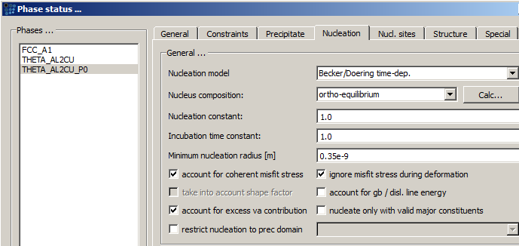
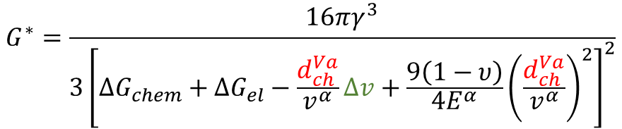
Why do we care?
$$G^{∗}=\frac{16πγ^{3}}{3{\left[{ΔG}_{chem}+{ΔG}_{el}−\frac{d_{ch}^{Va}}{v^{α}}Δv+\frac{9\left(1−υ\right)}{{4E}^{α}}{\left(\frac{d_{ch}^{Va}}{v^{α}}\right)}^{2}\right]}^{2}}$$

Slide 15
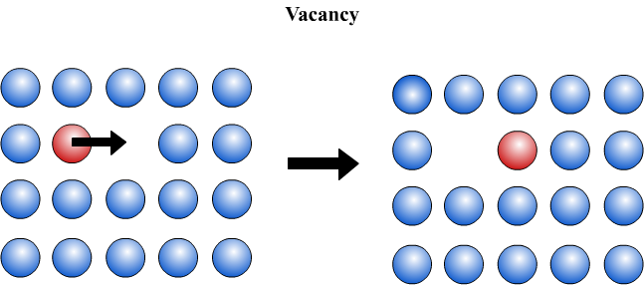
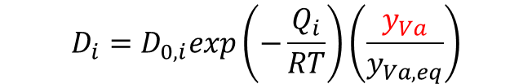
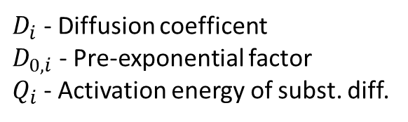
Why do we care?
Precipitation kinetics
Vacancies
Diffusion
$D_{i}$ - Diffusion coefficent
$D_{0,i}$ - Pre-exponential factor
$Q_{i}$ - Activation energy of subst. diff.
http://www.doitpoms.ac.uk/tlplib/diffusion/diffusion_mechanism.php

Slide 16
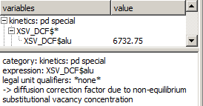
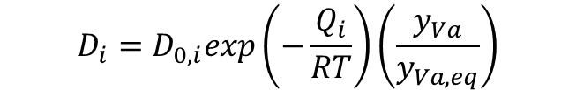
Why do we care?
Precipitation kinetics
Vacancies
Diffusion
$$D_{i}=D_{0,i}exp\left(−\frac{Q_{i}}{RT}\right)\left(\frac{y_{Va}}{y_{Va,eq}}\right)$$
http://www.doitpoms.ac.uk/tlplib/diffusion/diffusion_mechanism.php

Slide 17
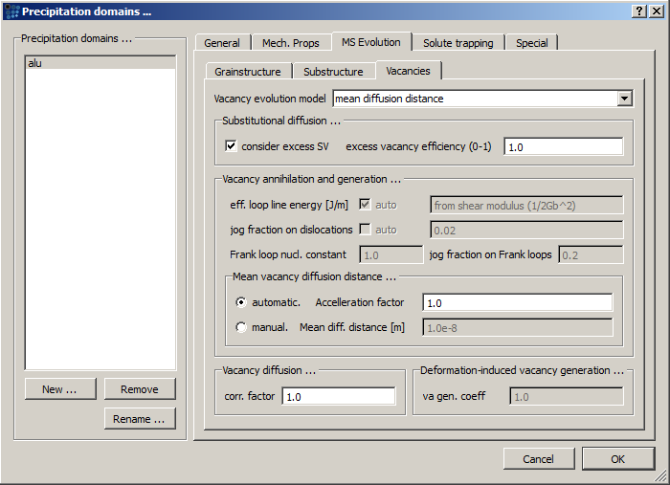
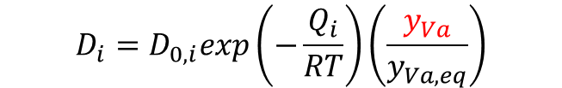
Why do we care?
Vacancies
Diffusion
$$D_{i}=D_{0,i}exp\left(−\frac{Q_{i}}{RT}\right)\left(\frac{y_{Va}}{y_{Va,eq}}\right)$$

Slide 18
How does it evolve?
Sources and sinks
Source
Material
Sink
Vacancy flow
Equilibrium → Generation rate at source = Anihilation rate at sink

Slide 19
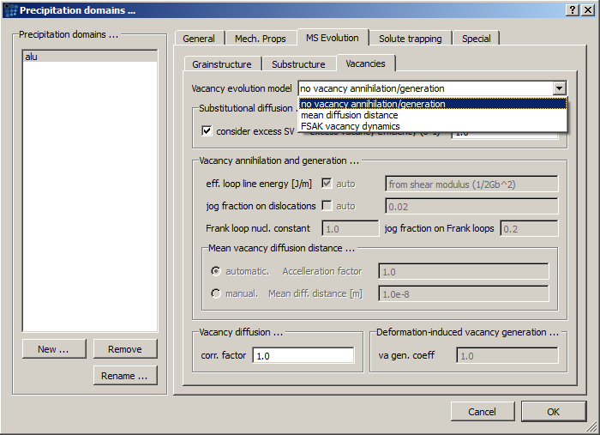
How does it evolve?
3 models in MatCalc:
  Mean diffusion distance
  „FSAK“* model
  Vacancy generation during the deformation (with FSAK only!)
* „Fischer-Svoboda-Appel-Kozeschnik“, Fischer et. al., Acta Mater. 59 (2011) 3463-3472

Slide 20



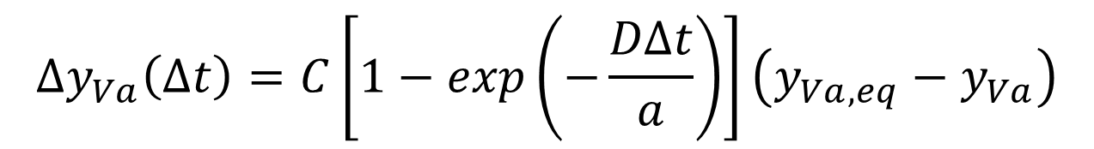



How does it evolve?
Mean diffusion distance
  Dislocations are taken as a vacancy source/sink
Default mean diffusion distance:
Evolution equation:
$a$ - Mean diffusion distance
$ρ$ – Dislocation density
$$a=10^\left(−0.5log\left(ρ \right)\right)$$
$C$ - Constant
$y_{i}$ - Element subst. site fraction
$$Δy_{Va}\left(Δt\right)=C\left[1−exp\left(−\frac{DΔt}{a}\right)\right]\left(y_{Va,eq}−y_{Va}\right)$$
$$D=\left(\frac{y_{Va}}{y_{Va,eq}}\right)\sum_{i}{{y_{i}D}_{i}}$$

Slide 21
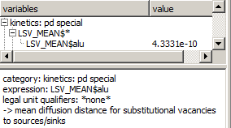

How does it evolve?
Mean diffusion distance
  Dislocations are taken as a vacancy source/sink
Default mean diffusion distance:
Evolution equation:
$$a=10^\left(−0.5log\left(ρ \right)\right)$$
$$Δy_{Va}\left(Δt\right)=C\left[1−exp\left(−\frac{DΔt}{a}\right)\right]\left(y_{Va,eq}−y_{Va}\right)$$
$$D=\left(\frac{y_{Va}}{y_{Va,eq}}\right)\sum_{i}{{y_{i}D}_{i}}$$

Slide 22

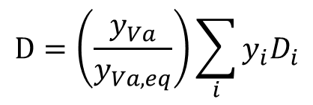
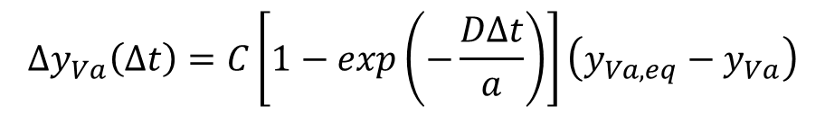
How does it evolve?
$$Δy_{Va}\left(Δt\right)=C\left[1−exp\left(−\frac{DΔt}{a}\right)\right]\left(y_{Va,eq}−y_{Va}\right)$$
Mean diffusion distance
  Dislocations are taken as a vacancy source/sink
Default mean diffusion distance
Evolution equation

Slide 23

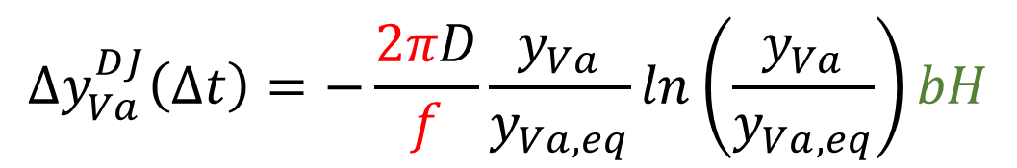

How does it evolve?
FSAK: Generation/anihilation on dislocation jogs
Evolution equation:
$$Δy_{Va}^{DJ}\left(Δt\right)=−\frac{2πD}{f}\frac{y_{Va}}{y_{Va,eq}}ln\left(\frac{y_{Va}}{y_{Va,eq}}\right)bH$$
$f$ – Diffusion correlation factor (0.75)
$b$ – Burger‘s vector
$H$ – Jog density
$x_{jog}$ – Jog fraction on dislocations
$$H=x_{jog}ρ$$

Slide 24
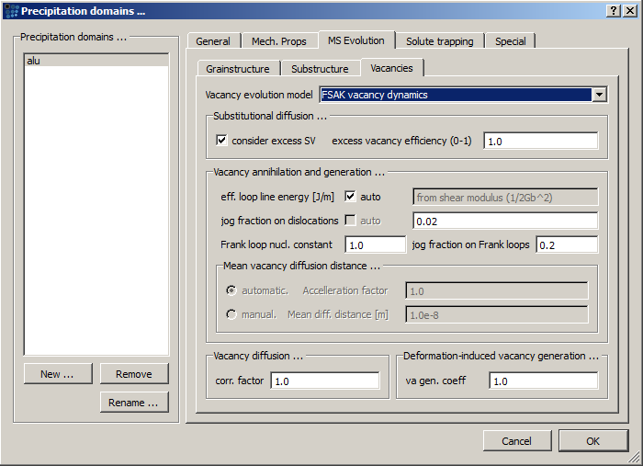
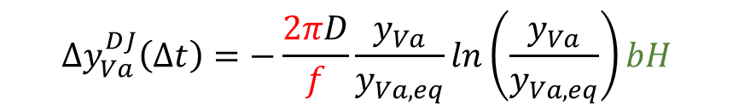

How does it evolve?
FSAK: Generation/anihilation on dislocation jogs
Evolution equation:
$$Δy_{Va}^{DJ}\left(Δt\right)=−\frac{2πD}{f}\frac{y_{Va}}{y_{Va,eq}}ln\left(\frac{y_{Va}}{y_{Va,eq}}\right)bH$$
$$H=x_{jog}ρ$$

Slide 25
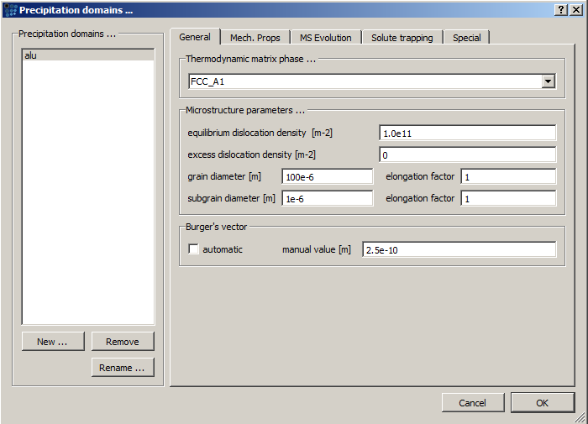

How does it evolve?
$$Δy_{Va}^{DJ}\left(Δt\right)=−\frac{2πD}{f}\frac{y_{Va}}{y_{Va,eq}}ln\left(\frac{y_{Va}}{y_{Va,eq}}\right)bH$$
$$H=x_{jog}ρ$$
FSAK: Generation/anihilation on dislocation jogs
Evolution equation:

Slide 26
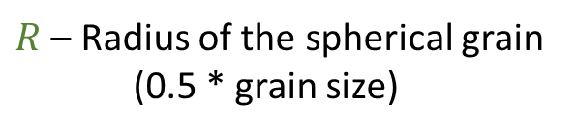
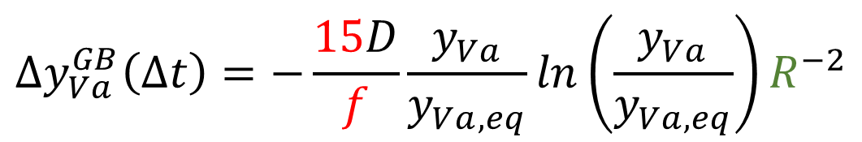
How does it evolve?
FSAK: Generation/anihilation on grain boundaries
Evolution equation:
$$Δy_{Va}^{GB}\left(Δt\right)=−\frac{15D}{f}\frac{y_{Va}}{y_{Va,eq}}ln\left(\frac{y_{Va}}{y_{Va,eq}}\right)R^{−2}$$
$R$ – Radius of the spherical grain
(0.5 * grain size)

Slide 27
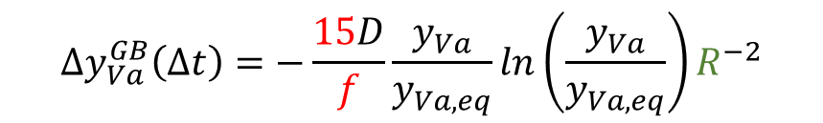
How does it evolve?
FSAK: Generation/anihilation on grain boundaries
Evolution equation:
$$Δy_{Va}^{GB}\left(Δt\right)=−\frac{15D}{f}\frac{y_{Va}}{y_{Va,eq}}ln\left(\frac{y_{Va}}{y_{Va,eq}}\right)R^{−2}$$

Slide 28
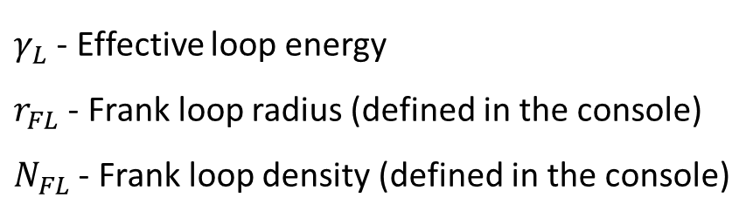
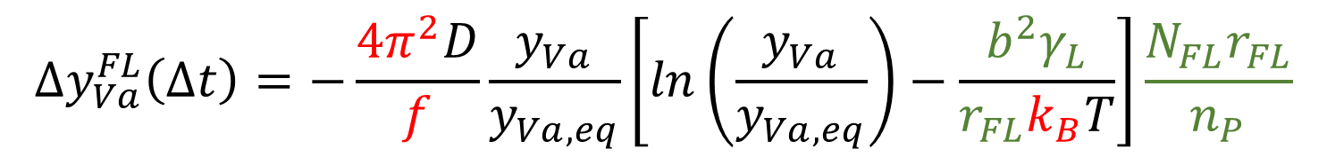

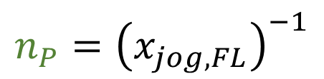
How does it evolve?
FSAK: Generation/anihilation on Frank loops (test-phase?)
Evolution equation:
$$Δy_{Va}^{FL}\left(Δt\right)=−\frac{4π^{2}D}{f}\frac{y_{Va}}{y_{Va,eq}}\left[ln\left(\frac{y_{Va}}{y_{Va,eq}}\right)−\frac{b^{2}γ_{L}}{r_{FL}k_{B}T}\right]\frac{N_{FL}r_{FL}}{n_{P}}$$
$$n_{P}={\left(x_{jog, FL}\right)}^{−1}$$
$γ_{L}$ - Effective loop energy
$r_{FL}$ - Frank loop radius (defined in the console)
$N_{FL}$ - Frank loop density (defined in the console)
$n_{P}$ - Jog spacing on Frank loops (number of atoms)
$x_{jog,FL}$ - Jog fraction on Frank loops
$k_{B}$ - Boltzmann constant

Slide 29

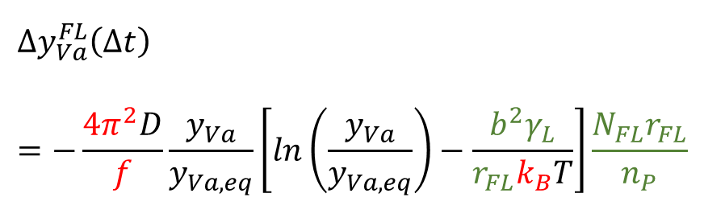

How does it evolve?
FSAK: Generation/anihilation on Frank loops (test-phase?)
Evolution equation:
$$Δy_{Va}^{FL}\left(Δt\right)=−\frac{4π^{2}D}{f}\frac{y_{Va}}{y_{Va,eq}}\left[ln\left(\frac{y_{Va}}{y_{Va,eq}}\right)−\frac{b^{2}γ_{L}}{r_{FL}k_{B}T}\right]\frac{N_{FL}r_{FL}}{n_{P}}$$
$$n_{P}={\left(x_{jog, FL}\right)}^{−1}$$

Slide 30
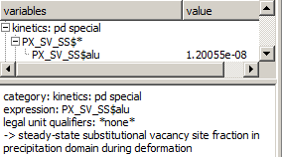
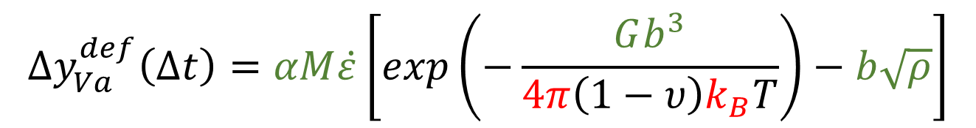


How does it evolve?
$$Δy_{Va}^{def}\left(Δt\right)=αM\dot{ε}\left[exp\left(−\frac{Gb^{3}}{4π\left(1−υ\right)k_{B}T}\right)−b\sqrt{ρ}\right]$$
$α$ – Constant
$M$ – Taylor factor
$G$ – Shear modulus
$\dot{ε}$ - Strain rate
$$y_{Va,eq}+y_{Va}^{def}$$
Vacancy generation during the deformation
Evolution equation:

Slide 31

How does it evolve?
$$Δy_{Va}^{Def}\left(Δt\right)=αM\dot{ε}\left[exp\left(−\frac{Gb^{3}}{4π\left(1−υ\right)k_{B}T}\right)−b\sqrt{ρ}\right]$$
Vacancy generation during the deformation
Evolution equation

Slide 32
Why does it take so long to evolve?
The idea:
  Some vacancies are trapped in the material and do not proceed to the sinks.
  Equilibrium between the trapped an „free-to-move“ vacancies
Needed:
  The amount of traps
  The trapping strength
  Relation between the amounts of trapped and free vacancies

Slide 33

Why does it take so long to evolve?
Possible traps
  Solute atoms
  Dislocations
  Grain- & subgrain boundaries
  Precipitate surface

Slide 34


Why does it take so long to evolve?
Possible traps
$N_{B}$ - Number of bulk sites
$N_{GB}$ - Number of sites at grain boundary
$N_{SGB}$ - Number of sites at subgrain boundary
$r_{dc}$ - Dislocation core radius (5*10⁻¹⁹ m)
$x_{i}$ - mole fraction of component „i“
$N_{j}$ - Number of precipitates in class „j“
$r_{j}$- Radius of precipitates in class „j“
$V_{at}$ - Atomic volume
Trapping site | Fraction of trapping sites
Solute atoms | $$x_{i}$$
Dislocations | $$πr_{dc}^{2}ρ$$
Grain boundary | $${N_{GB}}/{N_{B}}$$
Subgrain boundary | $${N_{SGB}}/{N_{B}}$$
Precipitate surface | $$4πV_{at}^{\frac{1}{3}}\left(\sum_{class}{N_{j}r_{j}^{2}}\right)$$

Slide 35



Why does it take so long to evolve?
Trap „strength“: delta H
Trap „range“ modifier: coordination number
$$K=exp\left(−\frac{ΔH}{RT}\right)$$
$ΔH$ - Trapping enthalpy

Slide 36




Why does it take so long to evolve?
The amount of traps
  Amount of lattice sites → expressed by molar volumes
$n_{tot}$ - Total number of lattice sites
$n_{L}$ - Number of sites on which the vacancy is free to move
$n_{S}$ - Number of sites on the vacancy traps
$n_{i}$ - Number of „i“-sites (e.g. $n_{L},n_{T}$)
$V_{m}$ - Molar volume (volume for $n_{tot}$ = 1)
$V_{m,i}$ - Volume of material containing 1 mole of „i“-sites
$x_{i}$ - Mole fraction of „i“-sites
$$n_{tot}=n_{L}+n_{T}$$
$$n_{i}V_{m,i}={n_{tot}V}_{m}$$
$$x_{i}=\frac{n_{i}}{n_{tot}}=\frac{V_{m,tot}}{V_{m,i}}$$
Svoboda J., Fischer F.D., Acta Mater. 60 (2012) 1211-1220

Slide 37


Why does it take so long to evolve?
The amount of traps
  Amount of lattice sites → expressed by molar volumes
For clarity:
$V_{m,i}$ is the volume of the material under consideration needed to have the amount of 1 mole of „i“-sites in it. The less „i“-sites in the material, the more of it is needed.
$V_{m,i}$ IS NOT the volume of 1 mole of „i“-sites! →The material does not consist of „i“-sites alone
$n_{tot}$ - Total number of lattice sites
$n_{L}$ - Number of sites on which the vacancy is free to move
$n_{S}$ - Number of sites on which the vacancy is trapped
$n_{i}$ - Number of „i“-sites (e.g. $n_{L},n_{T}$)
$V_{m}$ - Molar volume (volume for $n_{tot}$ = 1)
$V_{m,i}$ - Volume of material containing 1 mole of „i“-sites
$x_{i}$ - Mole fraction of „i“-sites
$$n_{tot}=n_{L}+n_{T}$$
$$n_{i}V_{m,i}={n_{tot}V}_{m}$$
$$x_{i}=\frac{n_{i}}{n_{tot}}=\frac{V_{m,tot}}{V_{m,i}}$$
Svoboda J., Fischer F.D., Acta Mater. 60 (2012) 1211-1220

Slide 38

Why does it take so long to evolve?
Vacancy balance
$x_{Va,tot}=y_{Va,tot}=x_{L}y_{Va,L}+x_{T}y_{Va,T}$=$\frac{V_{m,T}}{V_{m,T}+V_{m,L}}y_{Va,L}$+$\frac{V_{m,L}}{V_{m,T}+V_{m,L}}y_{Va,T}$
$y_{Va,i}$ - Site fraction of vacancies on „i“-sites (= fraction of „i“-sites occupied by the vacancies)
$V_{m,T}$ ← according fraction of trapping sites*coordination number
$V_{m,L}$ ← assumed as $V_{m,tot}$ (molar volume of system)
Svoboda J., Fischer F.D., Acta Mater. 60 (2012) 1211-1220

Slide 39



Why does it take so long to evolve?
Vacancy balance:
Minimization of free energy:
Combine these two above → solve for $y_{Va,L}$ and $y_{Va,T}$
The immobile vacancies → $x_{T}y_{Va,T}−x_{L}y_{Va,L}$
$x_{Va,tot}=y_{Va,tot}=x_{L}y_{Va,L}+x_{T}y_{Va,T}$=$\frac{V_{m,T}}{V_{m,T}+V_{m,L}}y_{Va,L}$+$\frac{V_{m,L}}{V_{m,T}+V_{m,L}}y_{Va,T}$
$$y_{Va}^{T}=\frac{y_{Va}^{L}}{K+y_{Va}^{L}\left(1−K\right)}$$
$$K=exp\left(−\frac{ΔH}{RT}\right)$$
Svoboda J., Fischer F.D., Acta Mater. 60 (2012) 1211-1220

Slide 40
Examples
Examples from MatCalc website (P2-1, P2-2)
  FSAK model
  Al-Cu system, 4.3 wt.% Cu
  Precipitates: TH_DP_GPB- (bulk), THETA_PRIME- (disl.), THETA_AL2CU- (disl.)
  Al-fcc domain

Slide 41

Examples
Al-Cu system (Example P2-1), tempered at 200°C

Slide 42

Examples
Al-Cu system (Example P2-1), tempered at 150°C

Slide 43

Examples
Al-Cu system (Example P2-1), tempered at 100°C

Slide 44

Examples
Al-Cu system (Example P2-1)

Slide 45

Examples
Al-Cu system (Example P2-2), influence of cooling rate

Slide 46

Examples
Al-Cu system (Example P2-2), influence of dislocation density

Slide 47
Examples
System Al-Mg-Si
Mg = 0,4 wt.%, Si = 1,1 wt.%
Mg5Si6_B_DP-precipiate. Nucleates at bulk sites
Al-fcc domain
Trapping sites: Mg (2600 J/mol) and Si (3500 J/mol) solute atoms.
FSAK model

Slide 48

Examples
Variation of grain size (FSAK)

Slide 49

Examples
Variation of grain size (FSAK)

Slide 50

Examples
Variation of trapping enthalpy (FSAK)

Slide 51

Examples
Variation of trapping enthalpy (FSAK)

