Slide 1
Trapping Modelling in MatCalc
Yao V Shan

Slide 2
Introduction
Trapping: atoms sticking to lattice defects (e.g. solute atoms, dislocations, grain boundaries, …)
Cottrell atmosphere seen as trapping of carbon atoms along dislocations
Pereloma et al. 2007

Slide 3
Given parameters
Trapping enthalpy ∆E: reduction of system energy per trapped atom
Nominal composition of trapped element c_{i}
Amount of trapping positions c_{def} (solute atoms: nominal composition of trapping element, dislocations: dislocation density)
Molar volume Ω
Temperature T

Slide 4
State variables
Concentration of free atoms (in lattice) and trapped atoms:
c_{L} c_{T}
Volumes corresponding one mole of lattice positions and trap positions:
V_{L} V_{T}
Site fractions in lattice positions and trap positions:
y_{L} y_{T}

Slide 5
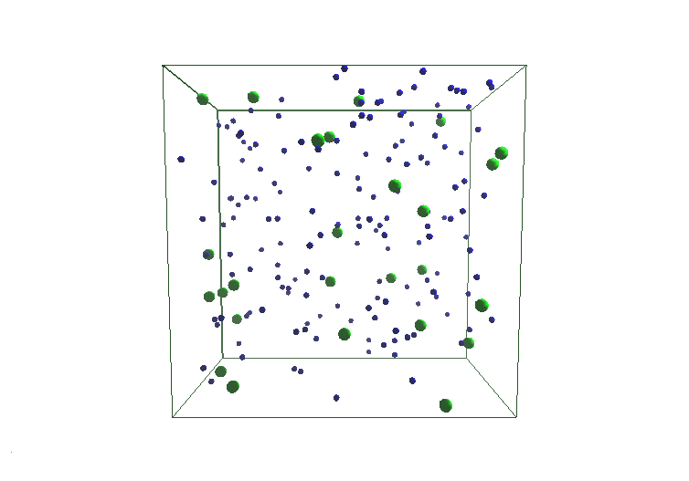
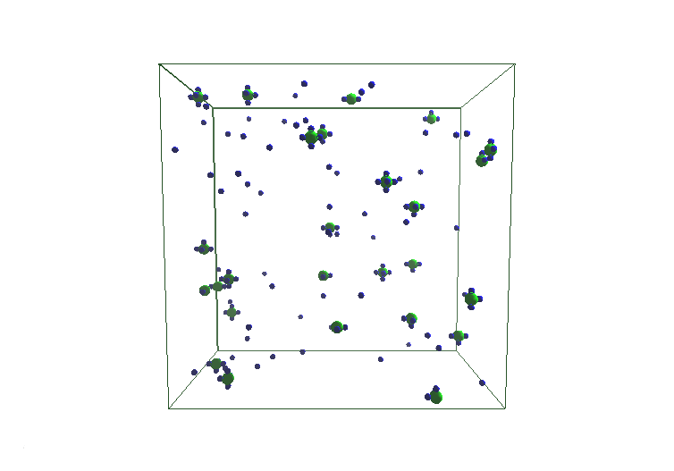
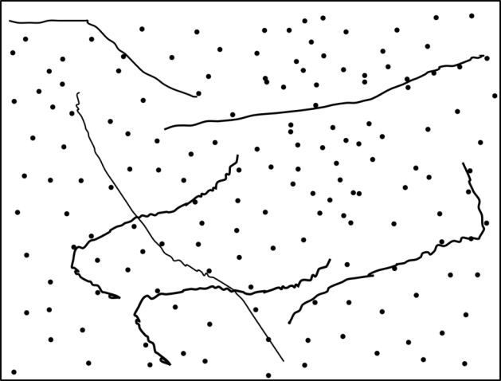
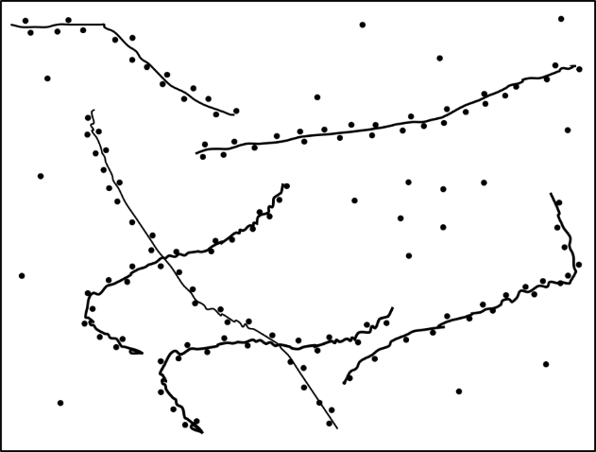
Trapping
On solutes:
On dislocations:

Slide 6
Constraints
Mass balance
Molar volume Ω
Defects generate the molar trapping volume
Site fractions

Slide 7
Thermodynamics
Gibbs energy:
Effect of trapping
S_{c} … configurational entropy
Ωc_{T} … moles of trapped atoms
∆E … trapping enthalpy

Slide 8
Configurational entropy
Bragg-Williams approximation
Dividing the lattice into free and trapped portions:
Ω/V_{L} … fraction of lattice sites
Ω/V_{T} … fraction of trap sites

Slide 9
Gibbs energy
Gibbs energy
Equilibrium
Applying constraints
Partial derivative

Slide 10
Gibbs energy derivation
Derivation
Simplifying to
Equilibrium equation
Oriani 1970

Slide 11
Exact analytical solution
Knowing
and
One can find y_{L} at equilibrium

Slide 12
Real system
Carbon on dislocations
Trapping enthalpy:
Coordination number Z for dislocations:
Around 15 C atoms on a screw dislocation plane at room temperature (edge dislocation about half as much):
(Clouet et al. 2008)
(Cochardt et al. 1955)
(Cochardt et al. 1955)

Slide 13
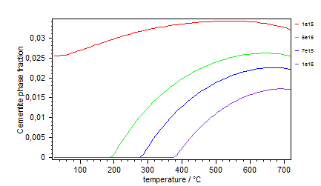
Effect of trapping
Cementite fraction over temperature
Increasing dislocation density dissolves cementite at lower temperatures
Dislocation density

Slide 14
Expansion to multi elements
Multi trapping: e.g. carbon and nitrogen
Gibbs energy
Equlibrium dG/dy_{L,C} = 0 and dG/dy_{L,N} = 0 leads to
McLean 1957

Slide 15
Expansion to multi traps
Gibbs energy
Equlibrium equations (i×k equations)
l = 1, 2, …, k
j = 1, 2, …, i

Slide 16
Kinetics
Kinetics are obtained from the balance equation for the Gibbs energy (thermodynamic extremal principle¹):
Total dissipation at dislocations in system due to carbon diffusion
a… acting radius of dislocation
R… radius surrounding dislocation in a unit cell
ρ… dislocation density
D… Diffusion coefficient of carbon
¹Svoboda et al. 2006

Slide 17
Kinetics
At dislocations:
At grain boundaries:
R… grain radius in a unit cell
δ… grain boundary thickness

Slide 18
Parameter study
Cottrell theory in dashed lines:

Slide 19
Summary
Thermodynamic model for describing various trapping effects
Derivations of the presented model lead to known equations, which has been used in empirical models for equilibrium
Expansion of model for multi components
Kinetic equations for slow non-equilibrium processes

Slide 20
More fun…
Chemical potentials
Extracting ∆E
from CALPHAD
data by comparing
chemical potentials
Ruda et al. 2009
Svoboda et al. 2011

Slide 21
More fun…
Diffusion coefficients
Trapping reduces the
effective diffusion
coefficient
Svoboda et al. 2011

