Slide 1
Performing Scheil-Gulliver (SG) analysis in MatCalc
(MatCalc 5.62.0013)
P. Warczok

Slide 2
Outline
Solid phase composition after alloy solidification
  Back-diffusion effect
  Primary precipitates
  Modeling of solid-solid transformation

Slide 3
Solid phase composition after alloy solidification

Slide 4
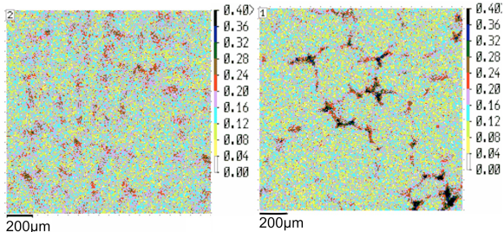
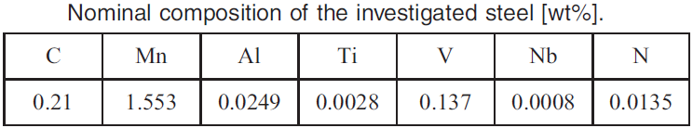
Solid phase composition
Experimental observation: Microsegregation in solidified phase
Pudar M. et al., Steel Res. Int. 81 (2010) 372-80

Slide 5
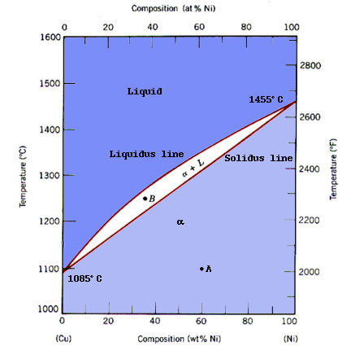
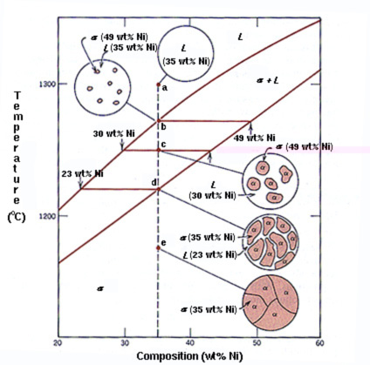
Solid phase composition
Theoretical estimation: equilibrium diagram
(43 wt% Ni)
http://www.sv.vt.edu/classes/MSE2094_NoteBook/96ClassProj/examples/cu-ni.html

Slide 6
Solid phase composition
Theoretical estimation: equilibrium diagram
Are these phase compositions real?
Yes, if diffusion in the phases is fast enough…
Diffusion in the solid phase is the limiting parameter
http://www.sv.vt.edu/classes/MSE2094_NoteBook/96ClassProj/examples/cu-ni.html

Slide 7
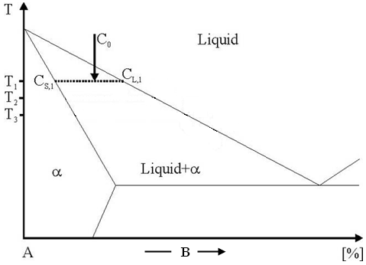
Solid phase composition
Theoretical estimation: stepped solidification
C_{L,1}
C_{S,1}
http://matcalc.tuwien.ac.at/index.php/documentation/detail.php?id=tutorials;t11&media=tutorials;t11;img;t11_figure1v2.png

Slide 8
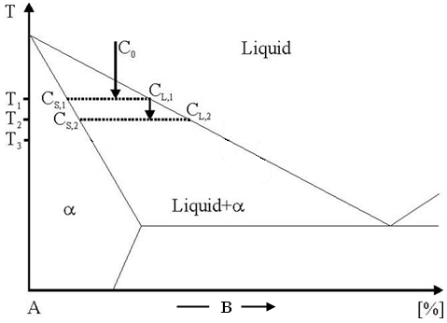
Solid phase composition
Theoretical estimation: stepped solidification
C_{L,2}
C_{S,2}
C_{S,1}
http://matcalc.tuwien.ac.at/index.php/documentation/detail.php?id=tutorials;t11&media=tutorials;t11;img;t11_figure1v2.png

Slide 9
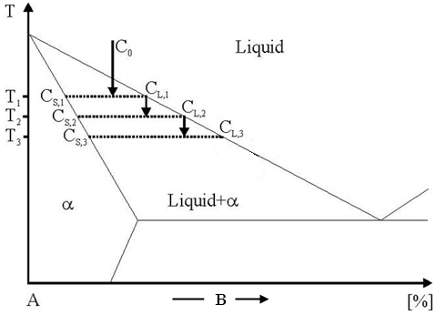
Solid phase composition
Theoretical estimation: stepped solidification
C_{L,3}
C_{S,3}
C_{S,2}
C_{S,1}
http://matcalc.tuwien.ac.at/index.php/documentation/detail.php?id=tutorials;t11&media=tutorials;t11;img;t11_figure1v2.png

Slide 10
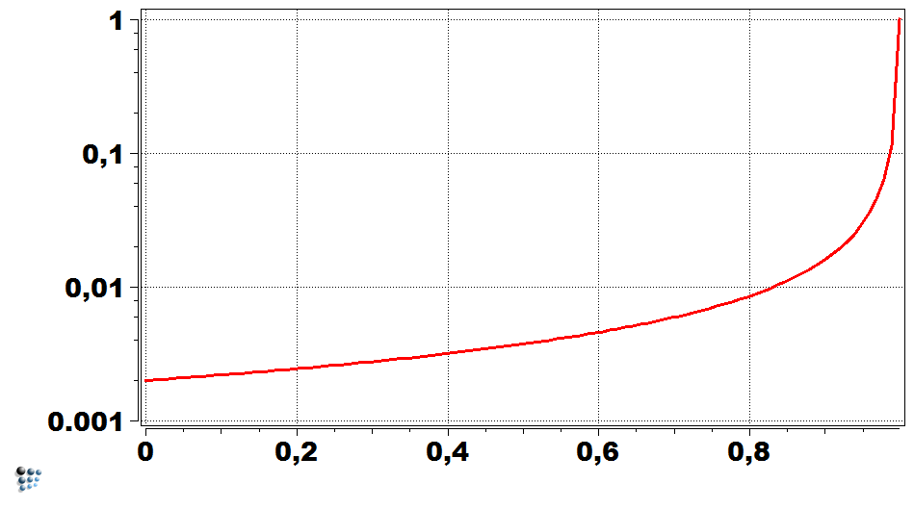












Solid phase composition
Theoretical estimation: Scheil equation
$$C_{S}=kC_{0}{\left(1−f_{S}\right)}^{k−1}$$
$$T$$
$$C_{0}$$
Liquid
$$C_{S}$$
$$C_{0}$$
L+S
$$f_{S}=0$$
$$C_{L}$$
Solid
$$k=\frac{C_{S}}{C_{L}}$$
$$f_{S}=1$$
$$C_{S}$$
$$f_{S}$$
$$x_{solute}$$
Gulliver G.H., J. Inst. Met. 9 (1913) 120-54
Scheil E., Z. Metall. 34 (1942) 70-72

Slide 11
Solid phase composition
Valid for k = const. !
Theoretical estimation: Scheil equation
$$C_{S}=kC_{0}{\left(1−f_{S}\right)}^{k−1}$$
Pro: Nice analytical solution
Contra: Formula dependent on system specification
$$C_{S}$$
$$C_{0}$$
$$f_{S}$$

Slide 12
What MatCalc does?
Stepped solidification → SG-calculation
Liquid(C_{L,1})
α(C_{S,1})
http://matcalc.tuwien.ac.at/index.php/documentation/detail.php?id=tutorials;t11&media=tutorials;t11;img;t11_figure1v2.png

Slide 13
What MatCalc does?
Liquid(C_{L,1})
New equilibrium phase α with solute content C_{S,1} created
Liquid composition set to C_{L,1}
α(C_{S,1})
http://matcalc.tuwien.ac.at/index.php/documentation/detail.php?id=tutorials;t11&media=tutorials;t11;img;t11_figure1v2.png

Slide 14
What MatCalc does?
Liquid(C_{L,2})
α(C_{S,2})
α_S(C_{S,1})
http://matcalc.tuwien.ac.at/index.php/documentation/detail.php?id=tutorials;t11&media=tutorials;t11;img;t11_figure1v2.png

Slide 15
What MatCalc does?
Previous α-phase is denoted now α_S
α_S gets a „dormant“ status (phase fraction and composition are „frozen“)
New equilib. phase α with solute content C_{S,2} created
Liquid composition set to C_{L,2}
Liquid(C_{L,2})
α(C_{S,2})
α_S(C_{S,1})
http://matcalc.tuwien.ac.at/index.php/documentation/detail.php?id=tutorials;t11&media=tutorials;t11;img;t11_figure1v2.png

Slide 16
What MatCalc does?
Liquid(C_{L,3})
α(C_{S,3})
α_S(C_{α})
http://matcalc.tuwien.ac.at/index.php/documentation/detail.php?id=tutorials;t11&media=tutorials;t11;img;t11_figure1v2.png

Slide 17
What MatCalc does?
α_S formed by merging the previous α_S and previous α (adding phase fractions)
α_S composition is evaluated from mass balance of the merged phases
„Dormant“ status set to α_S
New equilib. phase α with solute content C_{S,3} created
Liquid composition set to C_{L,3}
Liquid(C_{L,3})
α(C_{S,3})
α_S(C_{α})

Slide 18
What MatCalc does?
Liquid(C_{L,3})
Technical note
„α“-phase contains the fraction solidified at the considered temperature
„α_S“-phase contains all fractions solidified before the considered temperature
α(C_{S,3})
α_S(C_{α})

Slide 19
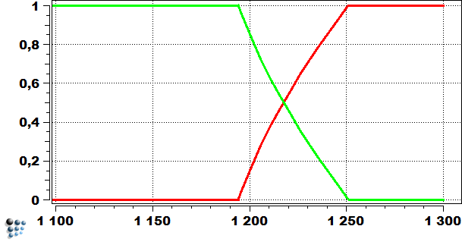
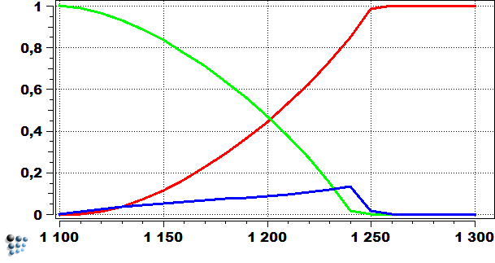
Example
Cu-Ni alloy, 35 wt.% Ni
Equilibrium calculation
SG-calculation
FCC_A1
Liquid
Liquid
FCC_A1_S
Phase fraction
Phase fraction
FCC_A1
Temperature [°C]
Temperature [°C]

Slide 20
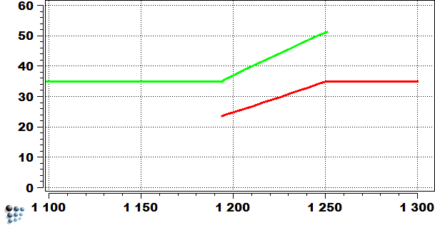
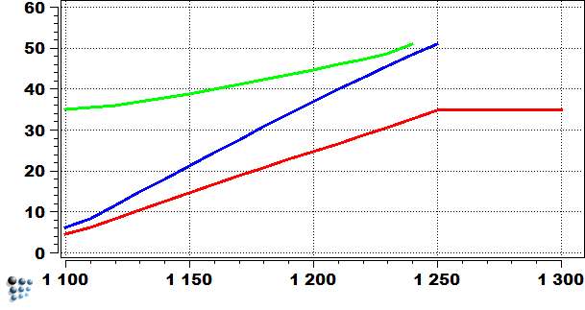
Example
Cu-Ni alloy, 35 wt.% Ni
Equilibrium calculation
SG-calculation
FCC_A1
FCC_A1_S
FCC_A1
Ni content [wt.%]
Liquid
Ni content [wt.%]
Liquid
Temperature [°C]
Temperature [°C]

Slide 21
Back-diffusion effect

Slide 22
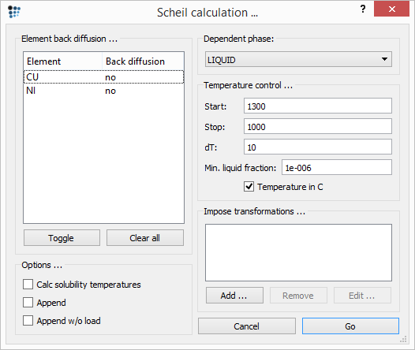
Backdiffusion
Some elements might be permitted to equilibrate fast between the liquid and solid phases
Relevant for interstitial elements (B,C,N) → diffuse fast enough on the interstitial lattice

Slide 23
Backdiffusion
Technical note
„_S“-phase has a „fixed phase fraction flag“ and constraints on u-fraction of elements with „no“ setting for back-diffusion (it is not „dormant“ any more)

Slide 24
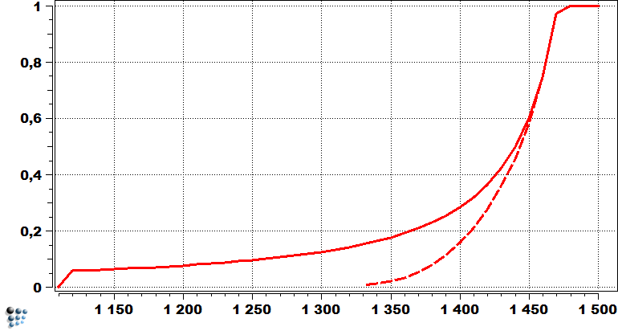
Example
Fe-Mn-C alloy, 3 wt.% Mn, 0.7 wt.% C (Tutorial 11)
Phase fraction
Liquid
Liquid
With BD
Temperature [°C]

Slide 25
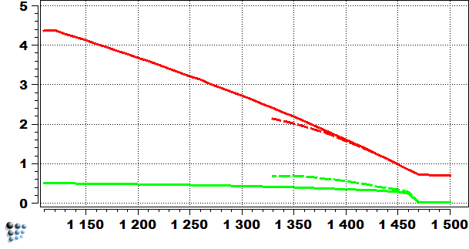
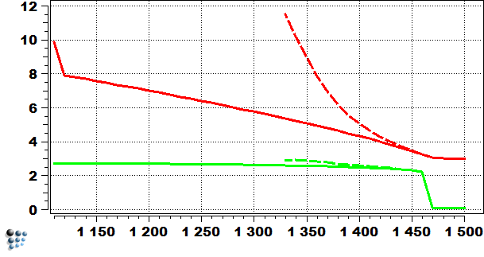
Example
Fe-Mn-C alloy, 3 wt.% Mn, 0.7 wt.% C (Tutorial 11)
Liquid
Liquid with BD
Liquid
C content [wt.%]
Liquid with BD
Mn content [wt.%]
FCC_A1_S with BD
FCC_A1_S
FCC_A1_S with BD
FCC_A1_S
Temperature [°C]
Temperature [°C]

Slide 26
Primary precipitates

Slide 27
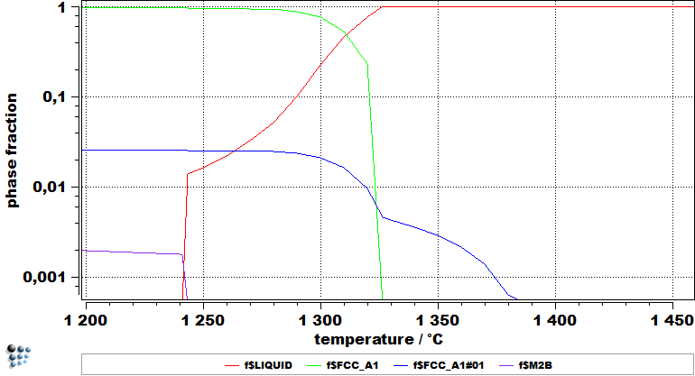
Primary precipitates
Primary precipitates → preciptates formed during the presence of the liquid phase
Phases coexistent with the liquid phase at the equilibrium calculation → strong candidates for the primary precipitates
Ni-Cr-Mo-Ti-B-C (0.25 wt.% C)
Equilibrium calculation

Slide 28
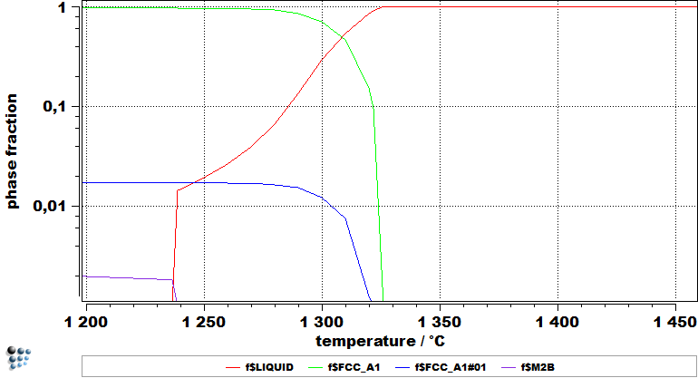
Primary precipitates
Primary precipitates are preciptates formed during the presence of the liquid phase
Phases coexistent with the liquid phase at the equilibrium calculation are strong candidates for the primary precipitates
Ni-Cr-Mo-Ti-B-C (0.1 wt.% C)
Equilibrium calculation

Slide 29
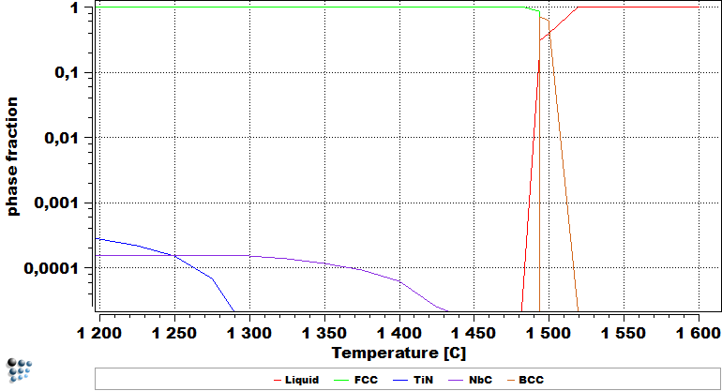
Primary precipitates
Primary precipitates are preciptates formed during the presence of the liquid phase
Phases coexistent with the liquid phase at the equilibrium calculation are strong candidates for the primary precipitates
Phases appearing close to the liquidus should be also checked
Fe-Nb-Ti-C-N (Example E20)
Equilibrium calculation

Slide 30
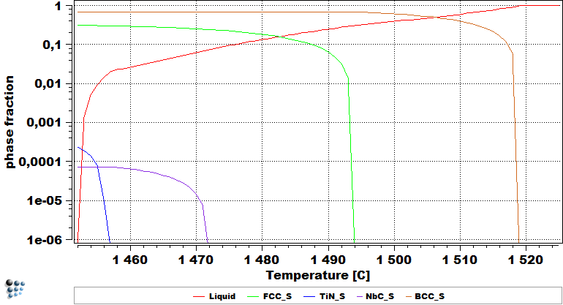
Primary precipitates
Primary precipitates are preciptates formed during the presence of the liquid phase
Phases coexistent with the liquid phase at the equilibrium calculation are strong candidates for the primary precipitates
Phases appearing close to the liquidus should be also checked
Fe-Nb-Ti-C-N (Example E20)
SG-calculation

Slide 31
Modeling of solid-solid transformation

Slide 32
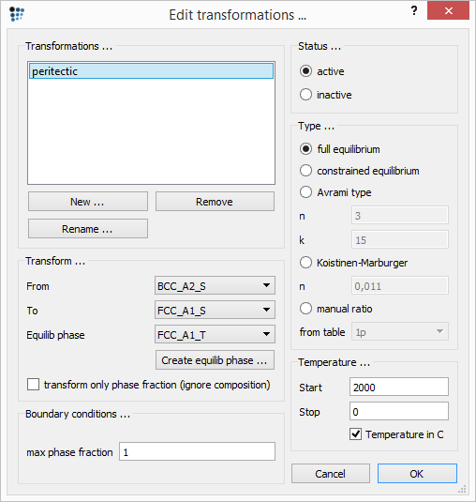
Solid-solid transformation
A solid phase might transform to another solid phase
Relevant for the peritectic reaction (e.g. δ-ferrite + liquid → austenite in steels)

Slide 33




Solid-solid transformation
Transformation type (calculation of the transformed phase ratio)
  Full equilibrium
  Constrained equilibrium
    As „full“, but the back-diffusion constraints are taken into account
  Avrami type
  Koistinen-Marburger
  Manual ratio
    Amounts taken from the table provided by user (Temperature vs. Amount transformed)
$$T_{frac}=\frac{T−T_{stop}}{T_{start}−T_{stop}}$$
$$f=1−exp\left(−kT_{frac}^{n}\right)$$
$$f=1−exp\left(−nT_{diff}^{}\right)$$
$$T_{diff}=T_{start}−T$$

Slide 34
Solid-solid transformation
Transformation type (calculation of the transformed phase ratio)
  Full equilibrium
  Constrained equilibrium
    As „full“, but the back-diffusion constraints are taken into account
  Avrami type
  Koistinen-Marburger
  Manual ratio
    Amounts taken from the table provided by user (Temperature vs. Amount transformed)
$$T_{frac}=\frac{T−T_{stop}}{T_{start}−T_{stop}}$$
$$f=1−exp\left(−kT_{frac}^{n}\right)$$
$$f=1−exp\left(−nT_{diff}^{}\right)$$
$$T_{diff}=T_{start}−T$$

Slide 35
Solid-solid transformation
Technical note
The „From“-phase is taken and transformed to „Equilib phase“-phase (with „_T“-suffix)
„Equilib phase“ might be created with „Create equilib phase…“ from parent phase of the „To“-phase
„_TS“-phase contains all fractions transformed before and at the considered temperature

Slide 36
Solid-solid transformation
Technical note
The „From“-phase is taken and transformed to „Equilib phase“-phase (with „_T“-suffix)
„Equilib phase“ might be created with „Create equilib phase…“ from parent phase of the „To“-phase
„_TS“-phase contains all fractions transformed before and at the considered temperature
Liquid(C_{L,1})
BCC_A2
BCC_A2_S
L0 → L1 + BCC_A2

Slide 37
Solid-solid transformation
Technical note
The „From“-phase is taken and transformed to „Equilib phase“-phase (with „_T“-suffix)
„Equilib phase“ might be created with „Create equilib phase…“ from parent phase of the „To“-phase
„_TS“-phase contains all fractions transformed before and at the considered temperature
FCC_A1
Liquid(C_{L,2})
BCC_A2_S
L1 → L2 + FCC_A1

Slide 38
Solid-solid transformation
Technical note
The „From“-phase is taken and transformed to „Equilib phase“-phase (with „_T“-suffix)
„Equilib phase“ might be created with „Create equilib phase…“ from parent phase of the „To“-phase
„_TS“-phase contains all fractions transformed before and at the considered temperature
FCC_A1
FCC_A1_S
Liquid(C_{L,3})
FCC_A1_TS
BCC_A2_S
L2 → L3 + FCC_A1
BCC_A2_S + L2 → FCC_A1_TS

Slide 39
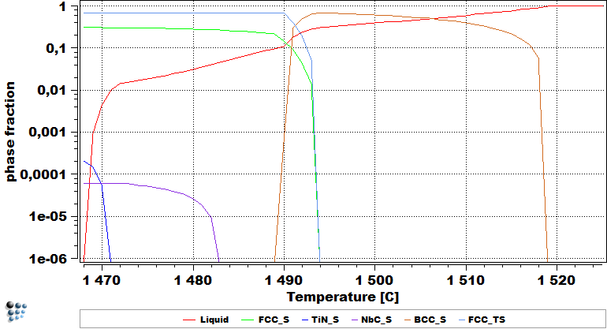
Solid-solid transformation
Fe-Nb-Ti-C-N (Example E20)
Without peritectic transformation
With peritectic transformation

Slide 40
Applications

Slide 41
What do I get from it?
Microsegregation limits obtained:
  Core composition: Composition of the very first „α“-phase appearing
  Intergranular composition: Composition of the liquid phase for a system with some defined liquid content
Cooling | Liquid phase fraction [at. %]
Air-cooling | 1
Continuous casting | 3
Arc furnace | 5

Slide 42
What do I get from it?
Example: Cu-Ni alloy, 35 wt.% Ni
Intergranular
Core
Liquid
FCC_A1_S
FCC_A1
FCC_A1_S
Phase fraction
Ni content [wt.%]
Liquid
FCC_A1
Temperature [°C]
Temperature [°C]

Slide 43
What do I get from it?
Primary precipitate characteristics (if present):
  Chemical composition
  Amount (Phase fraction)
Above parameters are taken from the system with the liquid phase fraction relevant to the solidification cooling rate
Cooling | Liquid phase fraction [at. %]
Air-cooling | 1
Continuous casting | 3
Arc furnace | 5

Slide 44
What do I get from it?
Example: Fe-Nb-Ti-C-N (Example E20)
TiN expected as a primary precipitate
Phase fraction ~1-2*10⁻⁵

Slide 45
Application
Example: Fe-Nb-Ti-C-N (Example E20&P20)
SG-calculation
- Identifying the compositions of solute-enriched and –depleted region
- Identifying the primary precipitates and their amounts
Precipitation kinetics simulation
- Introduction of the precipitate phases representing the primary precipitates
- Simulations performed for both compositions (solute-enriched and –depleted region)

Slide 46
Acknowledgments
Yao Shan
Georg Stechauner

