Slide 1
Nucleation sites of preciptates in MatCalc simulations
(MatCalc 5.61.0017)
P. Warczok

Slide 2
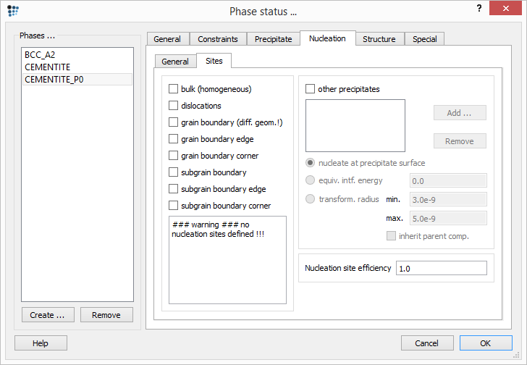
What is it all about?

Slide 3
What is it all about?
Consequences
  Number of available nucleation sites
  Interfacial energy model
  Precipitate growth & coarsening → nucleation on grain boundaries
  Special cases: Nucleation on/within precipitates

Slide 4
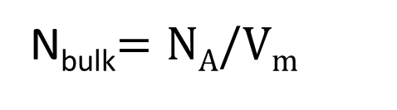


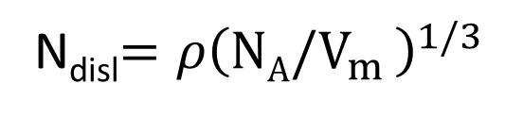
  Number of available nucleation sites
  Nucleation rate →
  Available nucleation sites – bulk
  Available nucleation sites – dislocations
  $$J\sim N_{x}$$
$J$ – Nucleation rate
$N_{x}$ – Number of nucleation sites
on $x$ position
$N_{A}$ – Avogadro number
$V_{m}$ – Molar volume
$ρ$ – Dislocation density
  N_{bulk}$=NA/Vm$
  N_{disl}$={ρ\left(NA/V_{m} \right)}^{1/3}$

Slide 5
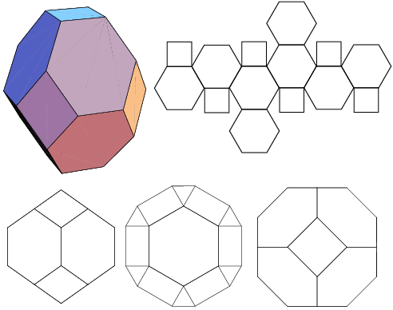
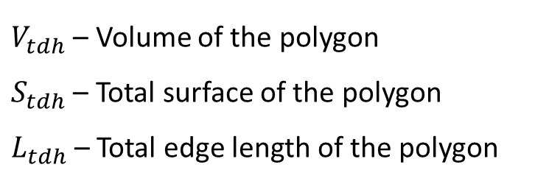



  Number of available nucleation sites
  Grain&subgrain boundaries – tetra(kai)decahedron concept
    Strictly: Truncated octahedron
a
  $$V_{tdh}=8\sqrt{2}a^{3}$$
  $$S_{tdh}=6\left(1+2\sqrt{3}\right)a^{2}$$
  $$L_{tdh}=36a$$
$V_{tdh}$ – Volume of the polygon
$S_{tdh}$ – Total surface of the polygon
$L_{tdh}$– Total edge length of the polygon
http://mathworld.wolfram.com/TruncatedOctahedron.html

Slide 6
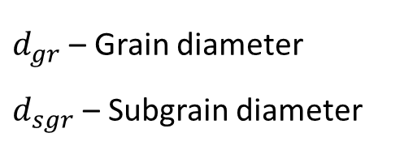

  Number of available nucleation sites
  Grain&subgrain boundaries – tetra(kai)decahedron concept
    Strictly: Truncated octahedron
  $$V_{tdh}=8\sqrt{2}a^{3}$$
  $$a=\frac{d_{gr/sgr}}{\sqrt{10}}$$
  $$S_{tdh}=6\left(1+2\sqrt{3}\right)a^{2}$$
  $$L_{tdh}=36a$$
$d_{gr}$ – Grain diameter
$d_{sgr}$ – Subgrain diameter
$V_{tdh}$ – Volume of the polygon
$S_{tdh}$ – Total surface of the polygon
$L_{tdh}$– Total edge length of the polygon

Slide 7
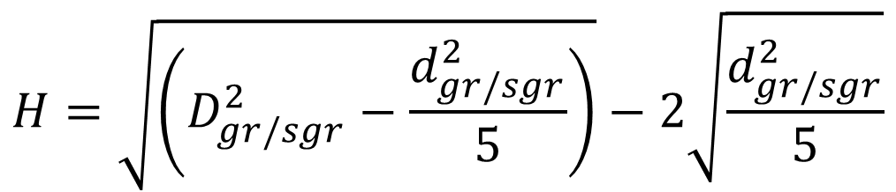



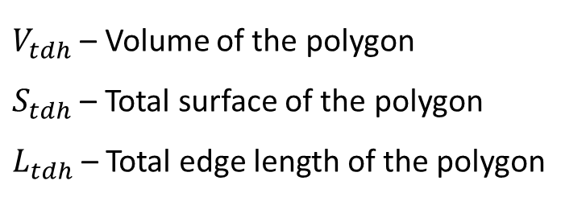

  Number of available nucleation sites
  Grain&subgrain boundaries – tetra(kai)decahedron concept
    Strictly: Truncated octahedron
  $$a=\frac{d_{gr/sgr}}{\sqrt{10}}$$
$d_{gr}$ – Grain diameter
$d_{sgr}$ – Subgrain diameter
$D_{gr}$ – Elongation factor for grains
$D_{gr}$ – Elongation factor for subgrains
  $$V_{tdh}=8\sqrt{2}a^{3}+6a^{2}H$$
  $$S_{tdh}=6\left(1+2\sqrt{3}\right)a^{2}+2a\left(2H+a\right)$$
  $$L_{tdh}=36a+8H$$
$V_{tdh}$ – Volume of the polygon
$S_{tdh}$ – Total surface of the polygon
$L_{tdh}$– Total edge length of the polygon
  $$H=\sqrt{\left(D_{gr/sgr}^{2}−\frac{d_{gr/sgr}^{2}}{5}\right)}−2\sqrt{\frac{d_{gr/sgr}^{2}}{5}}$$

Slide 8
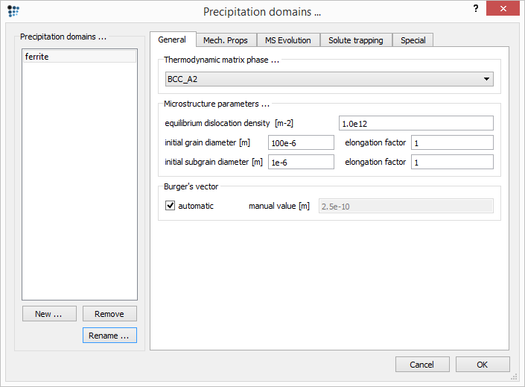
  Number of available nucleation sites
  Grain&subgrain boundaries – tetra(kai)decahedron concept
    Strictly: Truncated octahedron
  $$a=\frac{d_{gr/sgr}}{\sqrt{10}}$$
$d_{gr}$ – Grain diameter
$d_{sgr}$ – Subgrain diameter
$D_{gr}$ – Elongation factor for grains
$D_{gr}$ – Elongation factor for subgrains
  $$H=\sqrt{\left(D_{gr/sgr}^{2}−\frac{d_{gr/sgr}^{2}}{5}\right)}−2\sqrt{\frac{d_{gr/sgr}^{2}}{5}}$$

Slide 9
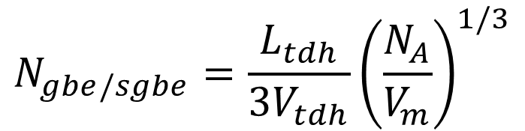
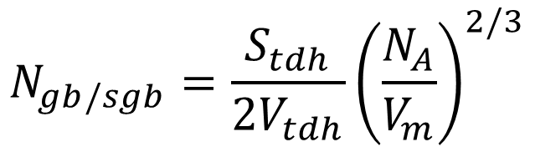
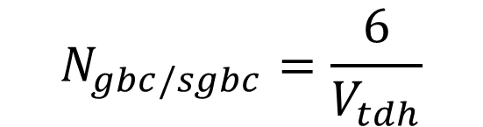
  Number of available nucleation sites
  Available nucleation sites – grain&subgrain boundaries
  Available nucleation sites – grain&subgrain boundary edges
  Available nucleation sites – grain&subgrain boundary corners
  $$N_{gb/sgb}=\frac{S_{tdh}}{2V_{tdh}}{\left(\frac{N_{A}}{V_{m}}\right)}^{2/3}$$
  $$N_{gbe/sgbe}=\frac{L_{tdh}}{{3V}_{tdh}}{\left(\frac{N_{A}}{V_{m}}\right)}^{1/3}$$
  $$N_{gbc/sgbc}=\frac{6}{V_{tdh}}$$

Slide 10
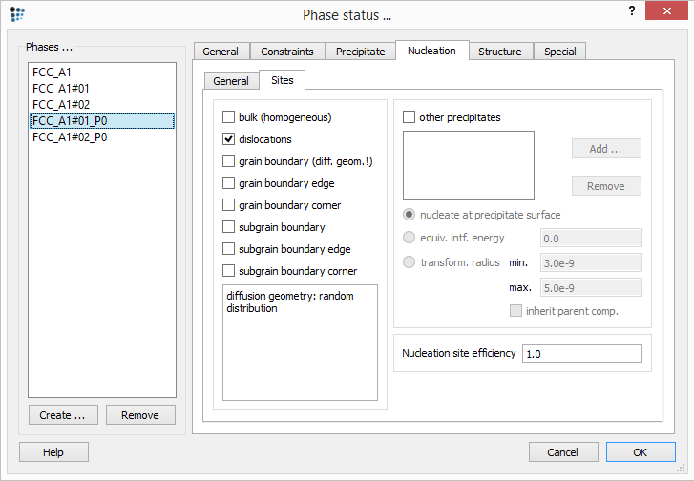
  Number of available nucleation sites
„Nucleation site efficiency“ scales linearly the number of available nucleation sites

Slide 11
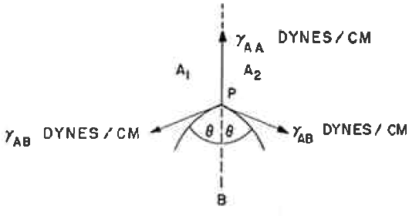
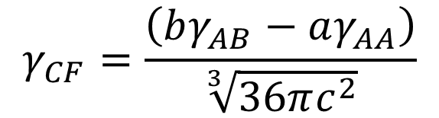



  Interfacial energy model
  Bulk & dislocations → standard interfacial energy evaluation
  Grain & subgrains (surface, edges, corners) → Clemm-Fisher model
  $$cosθ=\frac{γ_{AA}}{{2γ}_{AB}}$$
  $$a, b, c=f\left(cosθ\right)$$
$γ_{AA}$ – Grain boundary energy
$γ_{AB}$– Precipitate/matrix interfacial energy
  $$γ_{CF}=\frac{\left(bγ_{AB}−aγ_{AA}\right)}{\sqrt[3]{36πc^{2}}}$$
Clemm P.J., Fisher J.C., Acta Metall. 3 (1955) 70-73

Slide 12
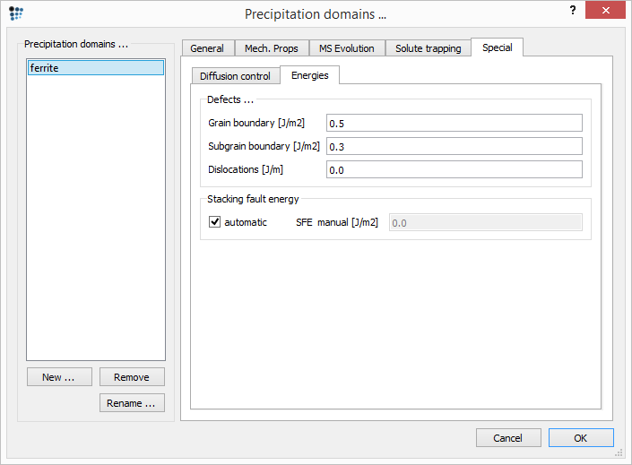
  Interfacial energy model
  Bulk & dislocations → standard interfacial energy evaluation
  Grain & subgrains (surface, edges, corners) → Clemm-Fisher model
$γ_{AA}$ – Grain boundary energy
$γ_{AB}$– Precipitate/matrix interfacial energy

Slide 13
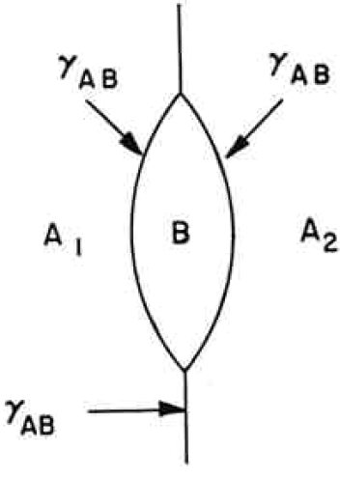

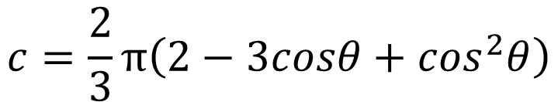

  Interfacial energy model
  Grain & subgrains surfaces
  $$a=π\left(1−\cos^{2}θ\right)$$
  $$b=4π\left(1−cosθ\right)$$
  $$c=\frac{2}{3}π\left(2−3cosθ+\cos^{2}θ\right)$$
Clemm P.J., Fisher J.C., Acta Metall. 3 (1955) 70-73

Slide 14
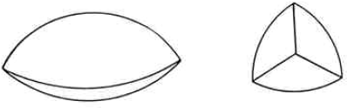

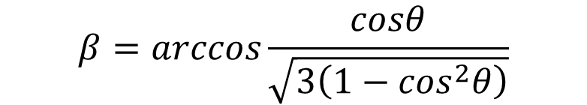
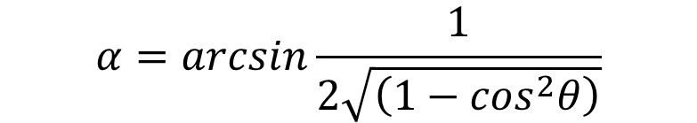
  Interfacial energy model
  Grain & subgrains edges
  $$a=3β\left(1−\cos^{2}θ\right)−cosθ\sqrt{\left(3−4\cos^{2}θ\right)}$$
  $$b=12\left(\frac{π}{2}−α−βcosθ\right)$$
  $$c=2\left(π−2α+\cos^{2}θ\sqrt{\left(3−4\cos^{2}θ\right)}−βcosθ\left(3−\cos^{2}θ\right)\right)$$
  $$α=arcsin\frac{1}{2\sqrt{\left(1−\cos^{2}θ\right)}}$$
  $$β=arccos\frac{cosθ}{\sqrt{3\left(1−\cos^{2}θ\right)}}$$
Clemm P.J., Fisher J.C., Acta Metall. 3 (1955) 70-73

Slide 15
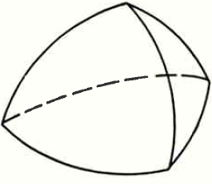
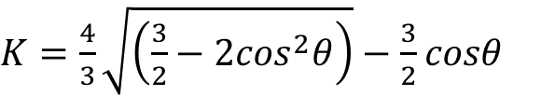


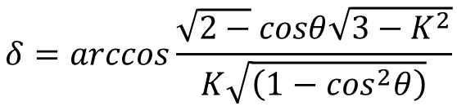
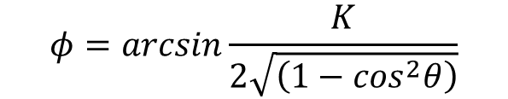
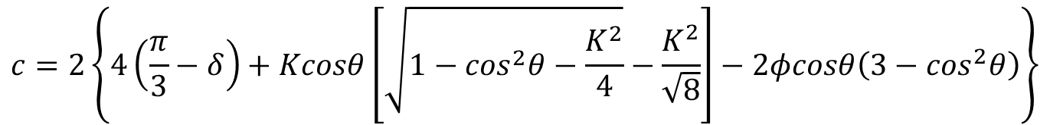
  Interfacial energy model
  Grain & subgrains corners
  $$a=3\left\{2φ\left(1−\cos^{2}θ\right)−K\left[\sqrt{1−\cos^{2}θ−\frac{K^{2}}{4}}−\frac{K^{2}}{\sqrt{8}}\right]\right\}$$
  $$b=24\left(\frac{π}{3}−φcosθ−δ\right)$$
  $$c=2\left\{4\left(\frac{π}{3}−δ\right)+Kcosθ\left[\sqrt{1−\cos^{2}θ−\frac{K^{2}}{4}}−\frac{K^{2}}{\sqrt{8}}\right]−2φcosθ\left(3−\cos^{2}θ\right)\right\}$$
  $K=\frac{4}{3}\sqrt{\left(\frac{3}{2}−2\cos^{2}θ\right)}−\frac{3}{2}$ $cosθ$
  $$φ=arcsin\frac{K}{2\sqrt{\left(1−\cos^{2}θ\right)}}$$
  $$δ=arccos\frac{\sqrt{2−}cosθ\sqrt{3−K^{2}}}{K\sqrt{\left(1−\cos^{2}θ\right)}}$$
Clemm P.J., Fisher J.C., Acta Metall. 3 (1955) 70-73

Slide 16
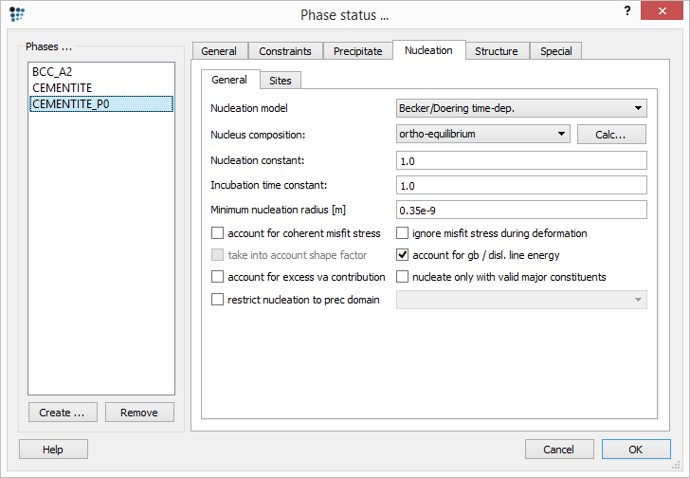
  Interfacial energy model
  Clemm-Fisher model needs to be activated!
Clemm P.J., Fisher J.C., Acta Metall. 3 (1955) 70-73

Slide 17
  Interfacial energy model
  Bulk & dislocations → standard interfacial energy evaluation
  Grain & subgrains (surface, edges, corners) → Clemm-Fisher model
  $$cosθ=\frac{γ_{AA}}{{2γ}_{AB}}$$
  $$a, b, c=f\left(cosθ\right)$$
$γ_{AA}$ – Grain boundary energy
$γ_{AB}$– Precipitate/matrix interfacial energy
  $$γ_{CF}=\frac{\left(bγ_{AB}−aγ_{AA}\right)}{\sqrt[3]{36πc^{2}}}$$
Clemm P.J., Fisher J.C., Acta Metall. 3 (1955) 70-73

Slide 18
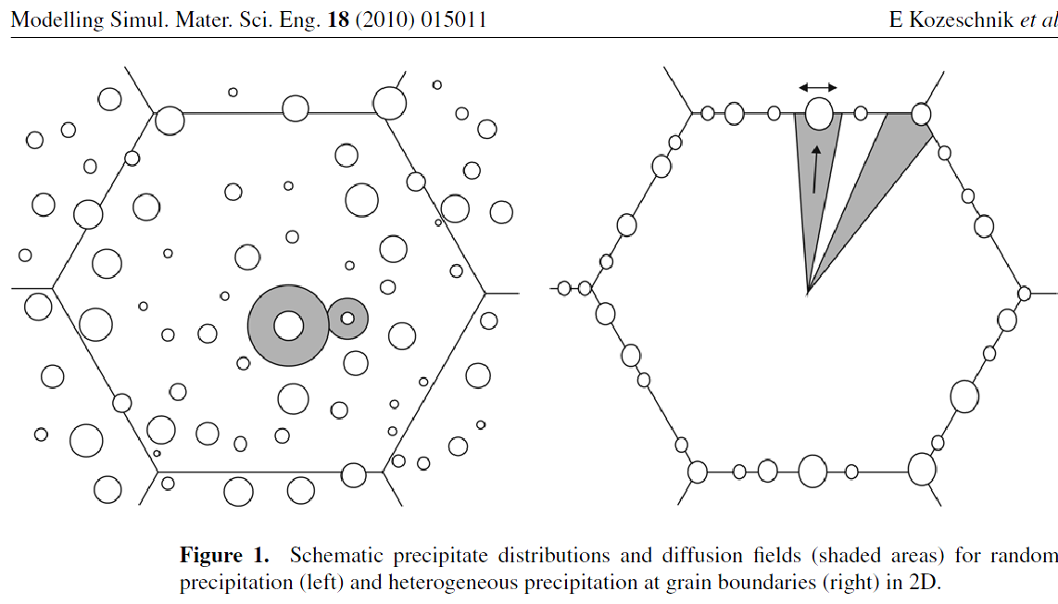
  Precipitate growth & coarsening
  Difference in diffusion fields

Slide 19
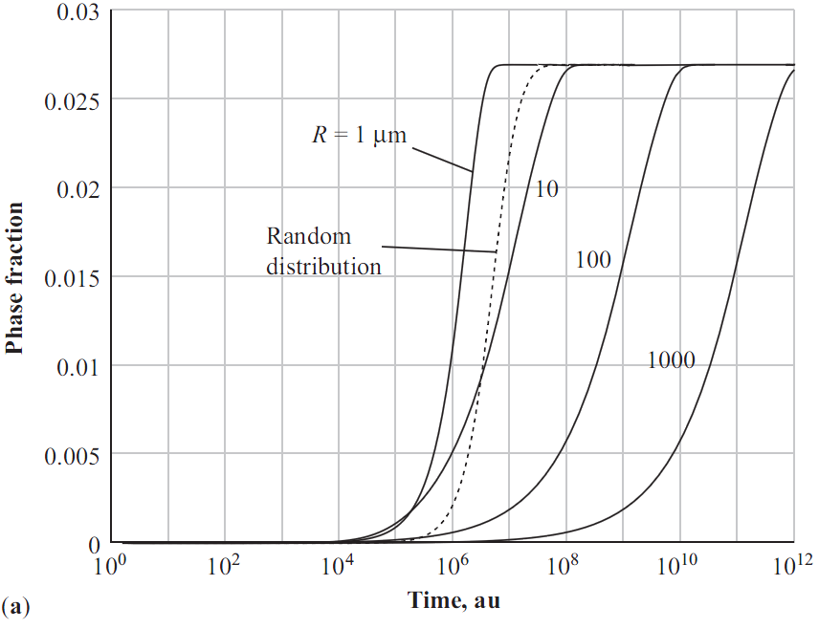
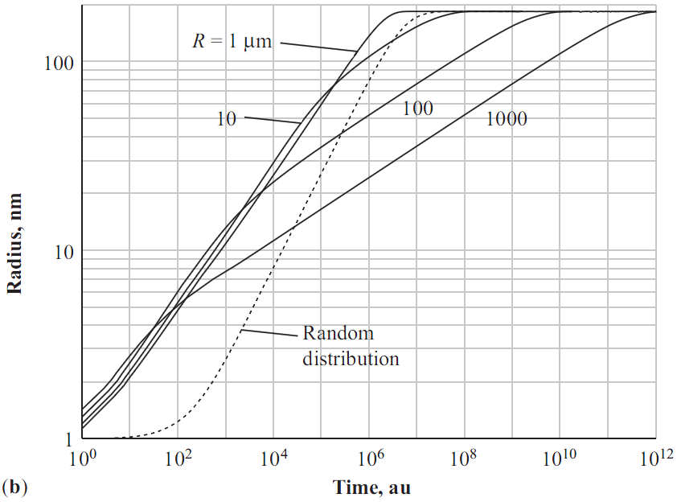
  Precipitate growth & coarsening
  Difference in diffusion fields → modification of radius evolution equations derived from thermodynamic extremum principle
Kozeschnik et al., Modelling Simul. Mater. Sci. Eng. 18 (2010) 015011

Slide 20
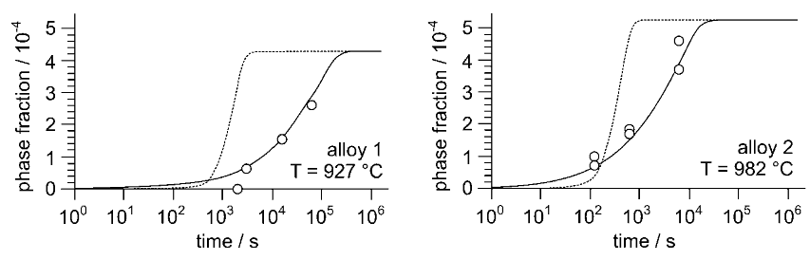
  Precipitate growth & coarsening
  Difference in diffusion fields → modification of radius evolution equations derived from thermodynamic extremum principle
Precipitation of AlN at austenite at grain boundaries
Kozeschnik et al., Modelling Simul. Mater. Sci. Eng. 18 (2010) 015011

Slide 21
  Precipitate growth & coarsening
  Difference in diffusion fields → modification of radius evolution equations derived from thermodynamic extremum principle
NOTE:
The grain boundary diffusion field model is automatically used when “grain boundary” is selected as the nucleation site
This model is relevant for the system with large grain size and small precipitate phase fractions.
In other cases, use the random diffusion field model → select other nucleation sites (e.g. “dislocations”) and adjust the available number of the nucleation sites using the “nucleation site efficiency”
Precipitation of AlN at austenite at grain boundaries
Kozeschnik et al., Modelling Simul. Mater. Sci. Eng. 18 (2010) 015011

Slide 22
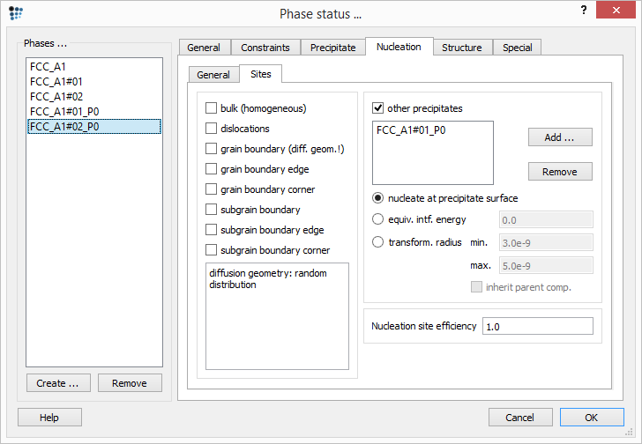
  Nucleation on the precipitate surface

Slide 23
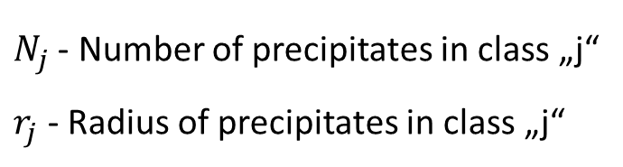
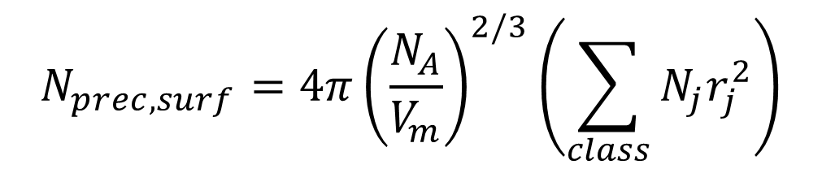
  Nucleation on the precipitate surface
  Available nucleation sites → atoms on the surface of the parent phase
  Parent phase is not modified by the nucleation of the new phase
$$N_{prec,surf}=4π{\left(\frac{N_{A}}{V_{m}}\right)}^{2/3}\left(\sum_{class}{N_{j}r_{j}^{2}}\right)$$
$N_{j}$ - Number of precipitates in class „j“
$r_{j}$- Radius of precipitates in class „j“

Slide 24
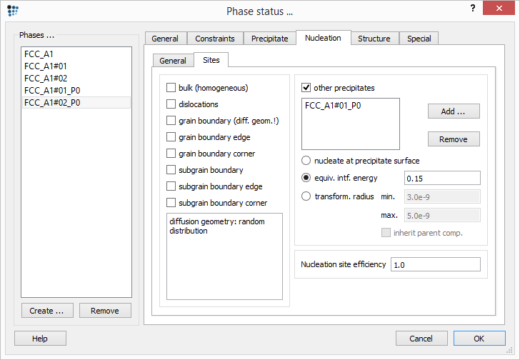
  Nucleation within the precipitate

Slide 25


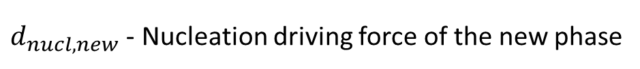
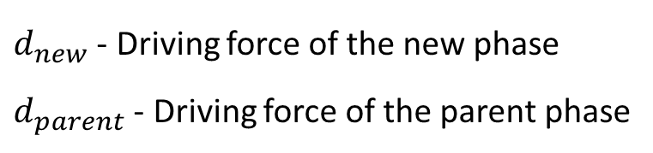
  Nucleation within the precipitate
  Available nucleation sites → atoms on the surface of the parent phase (as in the previous case)
  Nucleation → ,
  Interfacial energy defined by user, critical radius from parent prec.
  Parent phase transforms gradually into the new one
$$d_{new}>d_{parent}$$
$$d_{nucl, new}=d_{new}−d_{parent}$$
$d_{new}$ - Driving force of the new phase
$d_{parent}$ - Driving force of the parent phase
$d_{nucl, new}$ - Nucleation driving force of the new phase

Slide 26
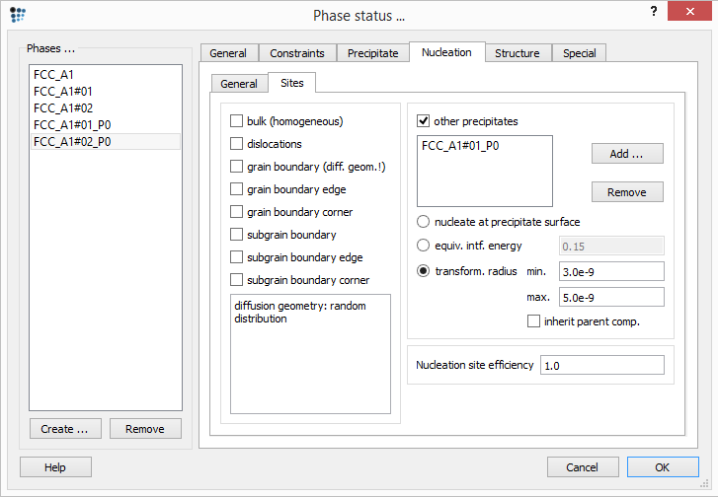
  Transformation of the precipitate

Slide 27


  Transformation of the precipitate
  „Transformation towards“ rather than „nucleation of“ the new precipitate
  Transformation condition: ,
  New precipitate size taken from the parent phase
  Initial precipitate composition might be taken from the parent phase
$$d_{new}>d_{parent}$$
$$d_{nucl, new}=d_{new}−d_{parent}$$

Slide 28
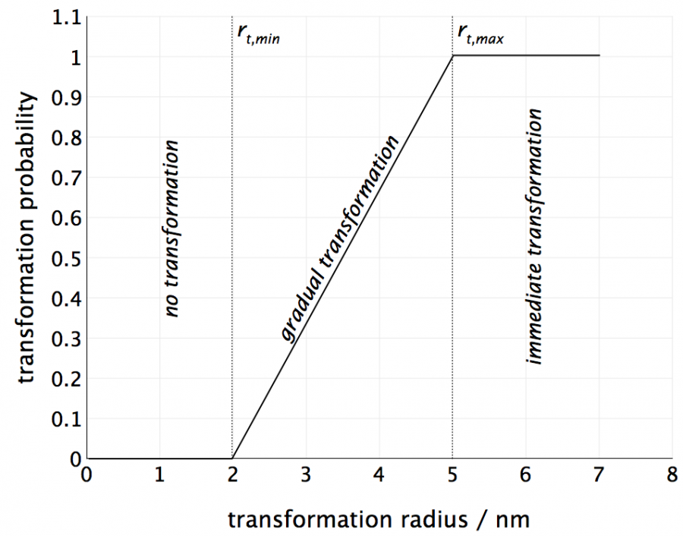
  Transformation of the precipitate
  Parent phase transforms gradually into the new one

Slide 29
  Transformation of the precipitate
  Parent phase transforms gradually into the new one

Slide 30
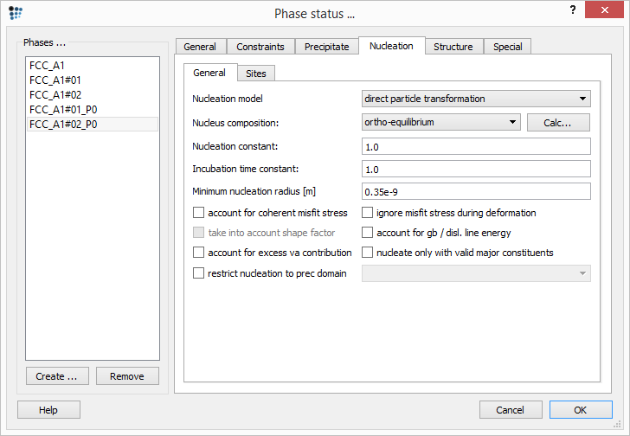
  Direct particle transformation
For the two last cases:
(nucleation within and transformation of the precipitate)
Change the nucleation model to „direct particle transformation“!

Slide 31
Acknowledgments
Yao Shan

